Slide 1
Node JS

Slide 2
What is Node JS?
Node JS is a java script runtime that uses the V8 Engine.
V8 Engine is an open source JavaScript engine written in C++ that takes JavaScript code and compiles it to machine code, it used inside Node JS and it used inside chrome browser.

Slide 3
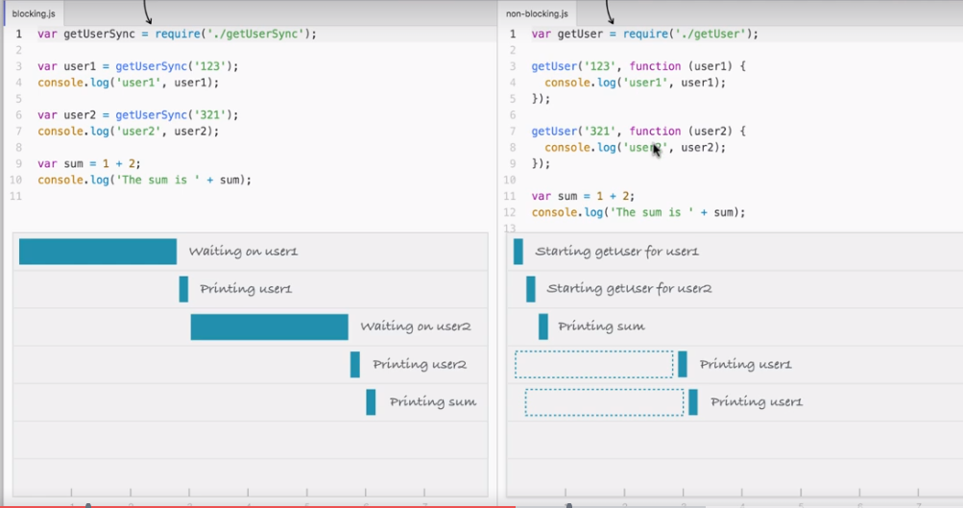
Why should I use Node JS?

Slide 4
Node JS uses an event-driven, non-blocking I/O model that makes it light weight and efficient.
Node is non blocking IO model that means not wait for response and for each request it will not create new thread ,it runs on single thread.so it is faster than blocking model.
In Blocking model as shown in the above diagram for each request it will create new thread.
In blocking model utilizing more CPU since it will create separate thread for each new request.

Slide 5
Modules in Node JS
Require: require function is used to load built in modules and third party modules.
const fs = require(‘fs’);→ loads file system module and store it in variable ‘fs’.
Option 1: fs.appendFile(‘greetings.txt’,’Hello World’); →write text to file
Option 2: fs.appendFile(‘greetings.txt’,’Hello World’,function(err){
If(err){
Console.log(‘unable to write to file’);
}
}
https://nodejs.org/api/ - all nodejs built-in modules

Slide 6
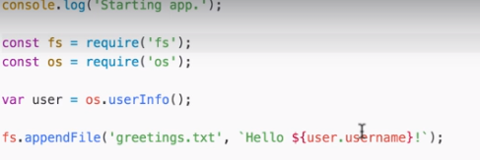
Option 3: fs.appendFileSync(‘greetings.txt’,’hello-world’);→synchronous mode
``astek operator (ES6 template text)– ES6 template text CAN WRITE INSIDE `` Operator `’hello’ +${user.username}`;
To write a JavaScript variable inside template text use $ symbol followed by curly braces {}.

Slide 7
Install atom essential packages for writing JS applications:
Atom-beautify
Atom-ternify –> to get auto complete code
Emmet – to get auto html code
Atom-live-server – to render html files in server
Todo
Pigments – Ctrl+Shift+P – to open command palette
Ask-stack – quickly get code samples and answers from stackoverflow in atom

